Slide 1
Parallel Connected Components
The Parallelepipeds:
Fabian Meier
Gustavo Segovia
Seraiah Walter

Slide 2
Our goal
Develop a high performance algorithm for connected components
Graph fits in memory

Slide 3
Our goal
Develop a high performance algorithm for connected components
Graph fits in memory

Slide 4
Algorithms – Related work
Basic serial
Transversal (BFS/DFS) – O(n + m)
Union find – O(m log(n))
Boost
Serial
Parallel
Randomized Contraction Parallel Connected Components
http://www3.cs.stonybrook.edu/~rezaul/Spring-2012/CSE613/CSE613-lecture-11.pdf

Slide 5
Algorithms – Ours
Lock free parallel transversal
Parallel BFS
Parallel BFS with atomics
Parallel spanning tree – inspired by union find

Slide 6
Algorithm details

Slide 7
Serial transversal
Unmarked vertices

Slide 8
Serial transversal
Algorithm starts at one vertex

Slide 9
Serial transversal
And transverses all connected vertices

Slide 10
Serial transversal
Continues to next unmarked vertex

Slide 11
Serial transversal
And marks each component

Slide 12
Serial transversal

Slide 13
Union find

Slide 14
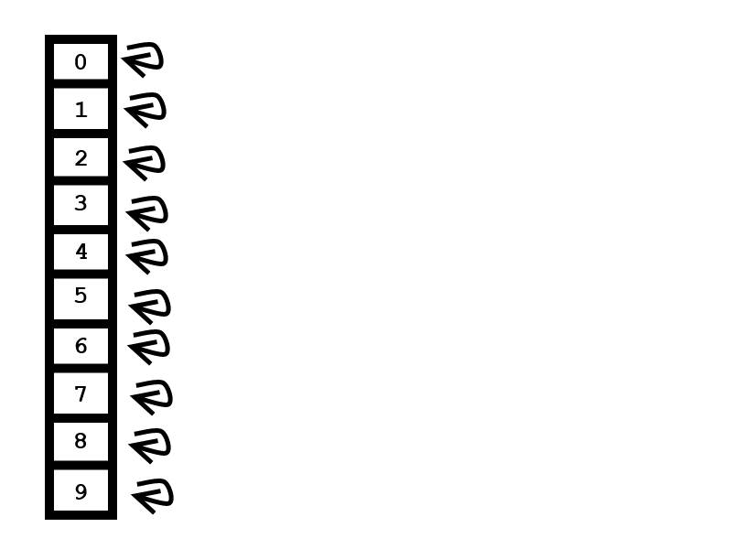
Union Find

Slide 15
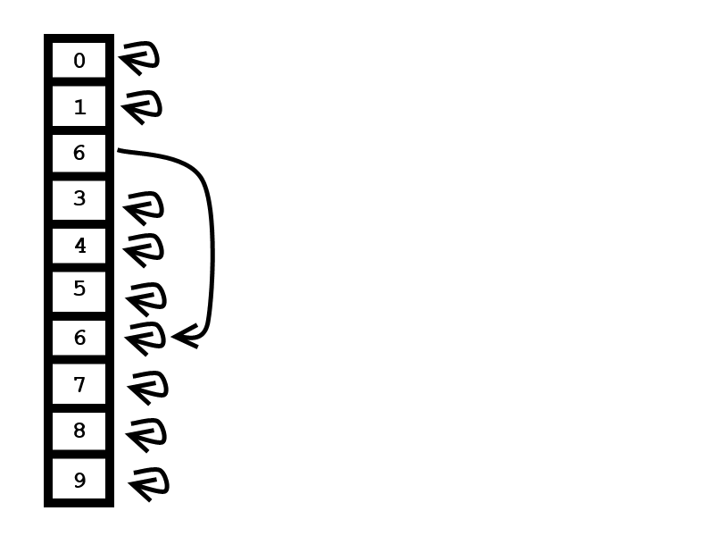
Union Find
edge 2-6

Slide 16
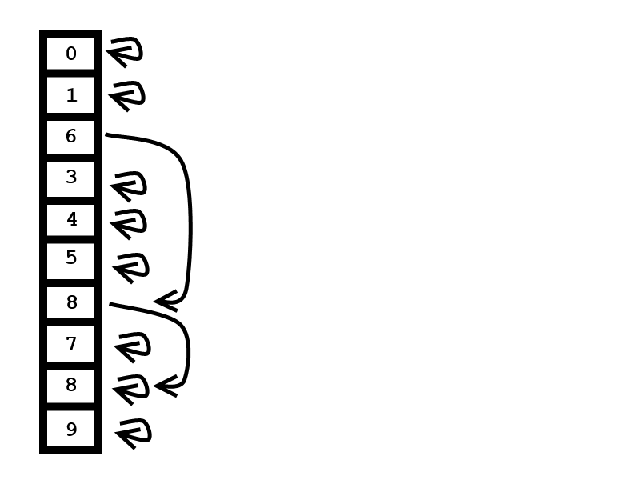
Union Find
edge 2-6
edge 2-8

Slide 17
Union find

Slide 18
Parallel spanning tree

Slide 19
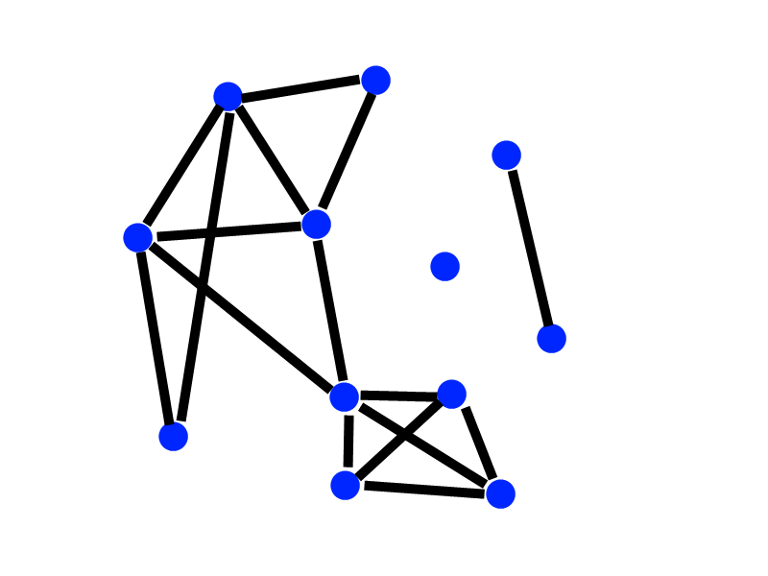
Parallel spanning tree

Slide 20
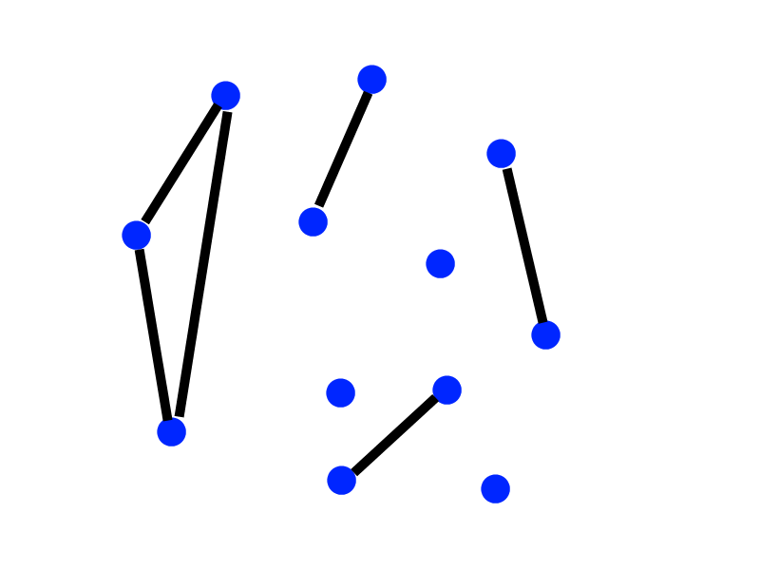
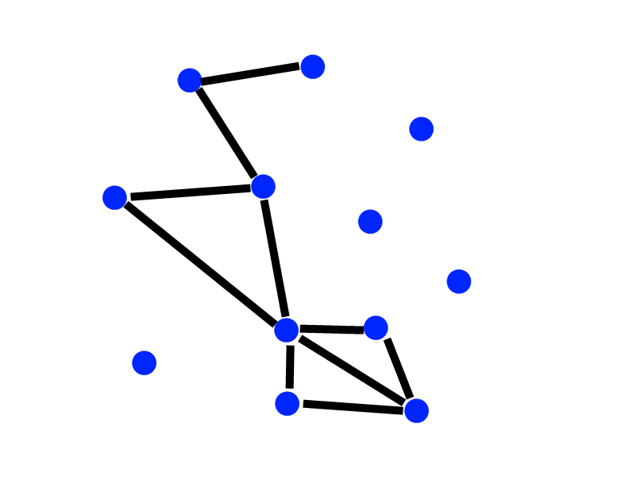
Parallel spanning treeTree

Slide 21
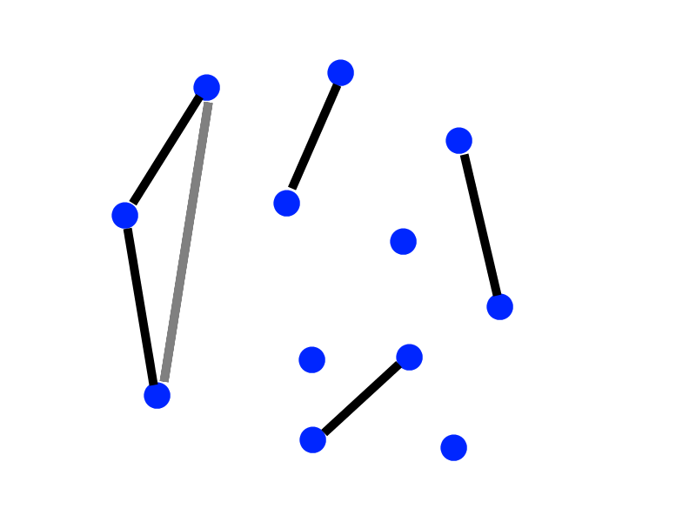
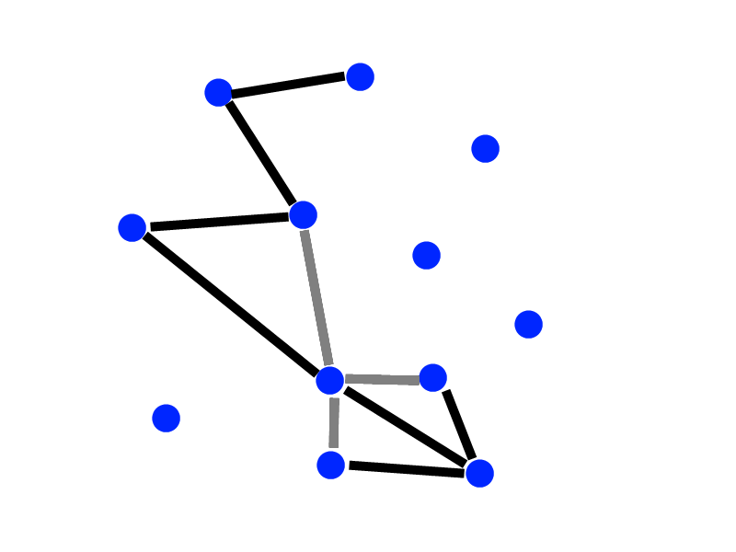
Parallel spanning tree

Slide 22
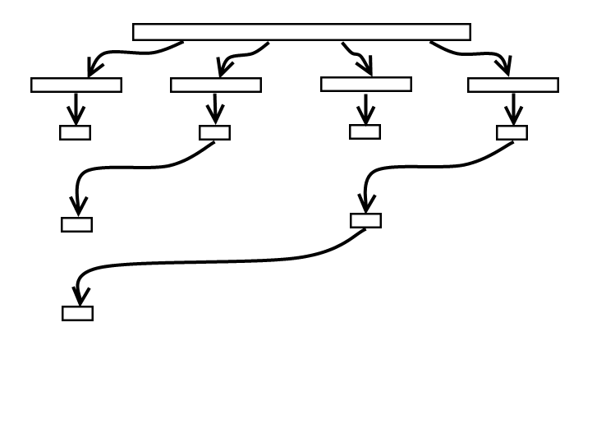
Parallel spanning tree
Runtime: O(m/p+ n*log(p))
Strong scaling in number of processors

Slide 23
Randomized contraction

Slide 24
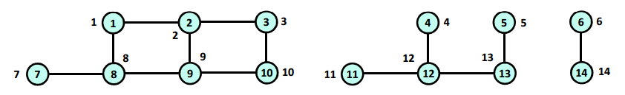
Randomized Contraction

Slide 25
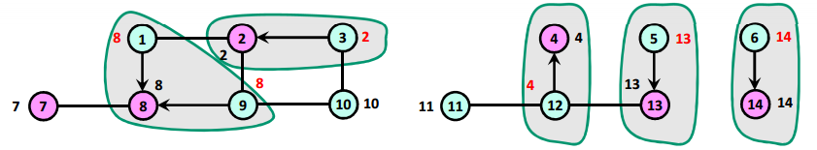
Randomized Contraction

Slide 26
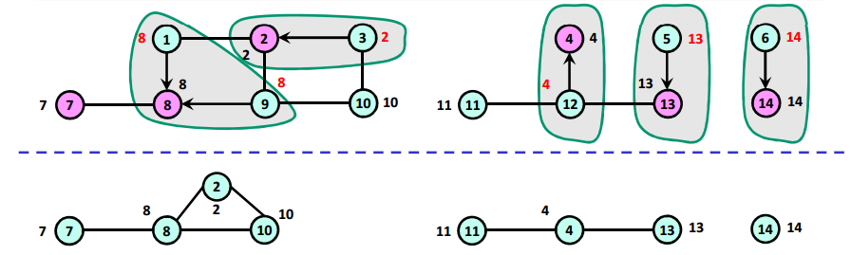
Randomized Contraction

Slide 27
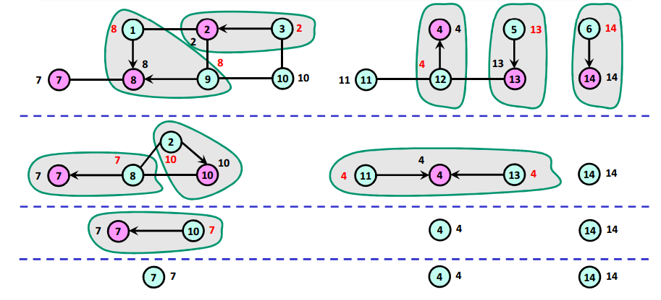
Randomized Contraction

Slide 28
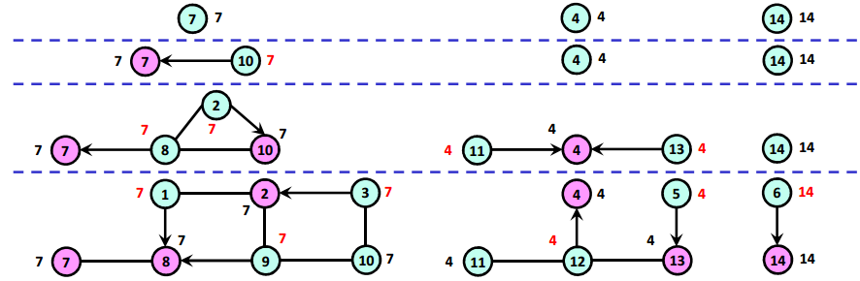
Randomized Contraction

Slide 29
Randomized Contraction

Slide 30
Parallel transversal

Slide 31
Parallel transversal
Unmarked vertices

Slide 32
Parallel transversal
Each thread starts at a vertex

Slide 33
Parallel transversal
Vertices are marked
When one thread hits a component marked by another thread, it makes an entry in the merge table

Slide 34
Parallel transversal
Vertices components are merged

Slide 35
Parallel transversal
Problem, thread might not notice it is marking a vertex that was already marked by another thread

Slide 36
Parallel transversal
Problem, thread might not notice it is marking a vertex that was already marked by another thread
Green thread
Yellow thread
Step 1
Step 1

Slide 37
Parallel transversal
Problem, thread might not notice it is marking a vertex that was already marked by another thread
Green thread
Yellow thread
Step 1
Step 1
Step 2

Slide 38
Parallel transversal
Problem, thread might not notice it is marking a vertex that was already marked by another thread
Green thread
Yellow thread
Step 1
Step 1
Step 2
Step 3

Slide 39
Parallel transversal
Problem, thread might not notice it is marking a vertex that was already marked by another thread
Green thread
Yellow thread
Step 1
Step 1
Step 2
Step 2
Step 3
Step 3

Slide 40
Parallel transversal
Problem, thread might not notice it is marking a vertex that was already marked by another thread
Yellow thread
Step 1
Step 1
Step 2
Step 2
Step 3
Step 3
Possible result:
(with no merge table entry!)

Slide 41
Parallel transversal
Solution 1: check if algorithm output is correct. If not, run again with 1 thread
Fast to check
Problem is very unlikely. Slow execution is amortized

Slide 42
Parallel transversal

Slide 43
Parallel transversal with atomics
Solution 2: Use test and set (atomic_flag)
Every time a thread marks a vertex, it makes sure no other thread marked it before with test and set
Each vertex has is own atomic_flag

Slide 44
Parallel transversal with atomics

Slide 45
Algorithm results

Slide 46
Runtime varying the number of vertices

Slide 47
Memory usage varying the number of vertices
Notes:
Bfs/pbfs/atomicbfs create adjacency list
Boost does too, but it is absurdly big
Ufind works directly with input

Slide 48
Runtime varying the number of components

Slide 49
Runtime varying the number of threads
Notes:
Serial algos shown as straight lines

Slide 50
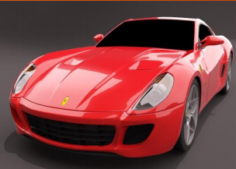
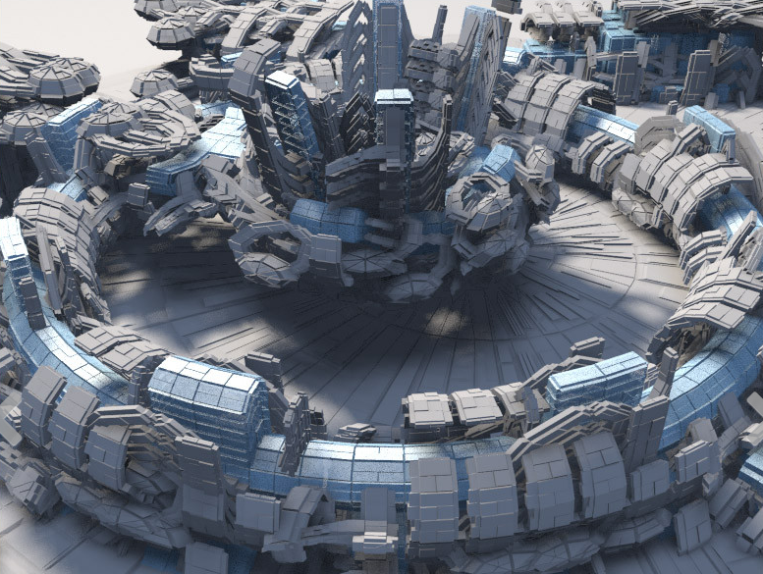
Runtime on real world graphs
~350 thousand vertices
~700 thousand edges
753 components
~1.2 million vertices
~2.4 million edges
6617 components
Notes:
Program developed to convert .obj files
Number components checked with program called trimesh2, programming used for processing meshes

Slide 51
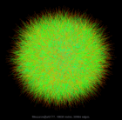
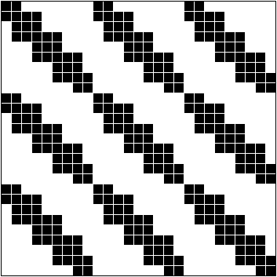
Runtime on real world graphs
608 vertices
1216 edges
1 component
~10 thousand vertices
~31 thousand edges
135 components
Notes:
Program developed to convert .obj files
Number components checked with program called trimesh2, programming used for processing meshes

Slide 52
Conclusions and lessons learned
Different algorithms are right for different situations
Best for small graphs: union find
Best for large graphs: parallel transversal with atomics
Should use algorithm that matches graph datastructure (not worth the time switching)
Extra threads can help runtime up to a limit
Boost is very bloated in terms of memory and not difficult to beat in runtime
It is not a good idea to take measurements on a shared Xeon phi on the weekend before final presentation (5 hour queue)

Slide 53
Thank you

